Slide 1

Travel Expert
Software Project
PRESENTER: John, Megha, Brian and Mahmood
November 21, 2014

Slide 2
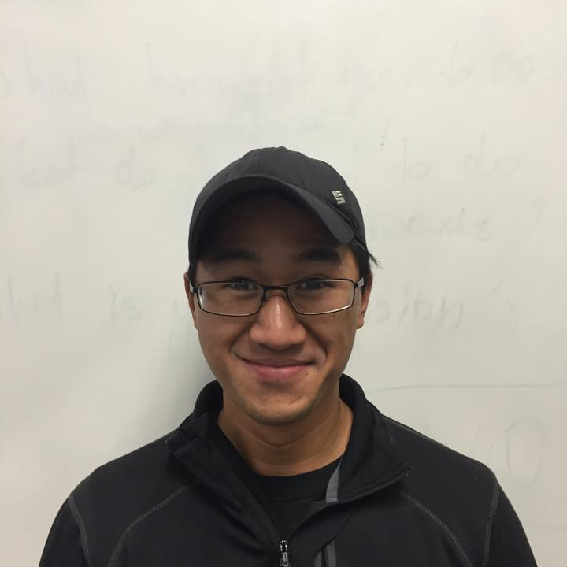
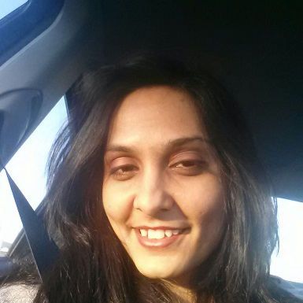
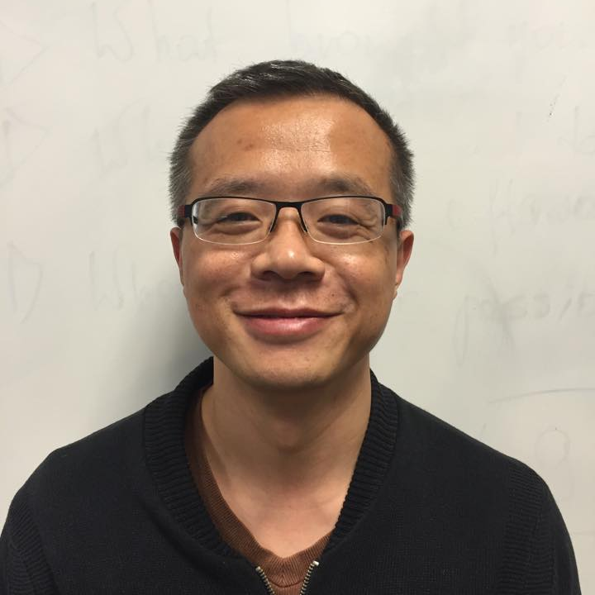
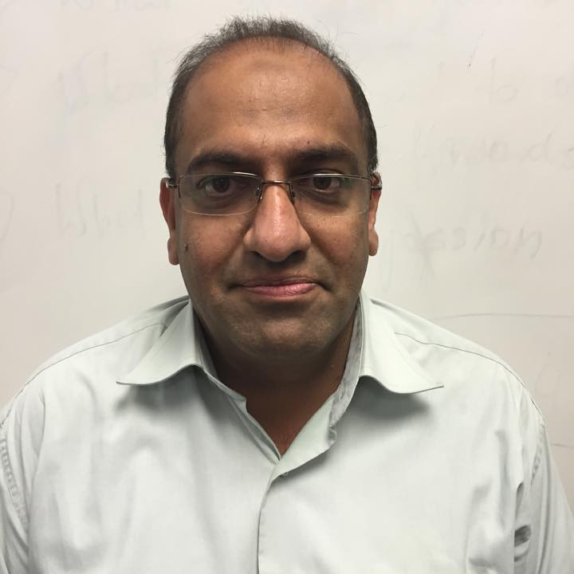
The MMBJ Team
John
Megha
Brian
Mahmood
Team Lead
Software developer
Software developer
Software developer

Slide 3
Goals
User friendly system and interface
Easy to store information for customers and agents
Application compatibility with hardware and software
Quality of majorability
Ability to collect feedback
Specialization among agents

Slide 4
Objectives
Reducing customer complaints by 80%
Improving time management
Efficient booking by reducing complexity

Slide 5
Assumptions - Contingencies
1
Users technical skills
1
User training / orientation of system
2
Hardware failure
2
Daily backups
3
OS / software failure
3
Antivirus software
4
System performance
4
Server supporting user requests
5
Office power system failure
5
UPS: Uninterrupted Power Supply system
6
Reporting conflicts / variations
6
Keeping hard copies for 3 months

Slide 6
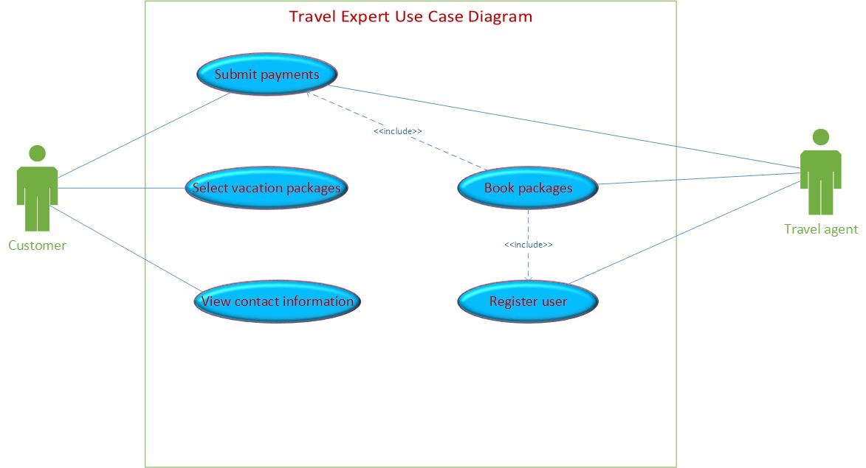
Use Case diagram

Slide 7
Scope definition
Database design
Application development
Web based menu
Web based reports
Placing order online

Slide 8
Additional Features
Future Implementation
Agent Login
Language translation
Comprehensive packages e.g. car rentals, hotels, bookings, airlines etc.

Slide 9
for being here

